Slide 1
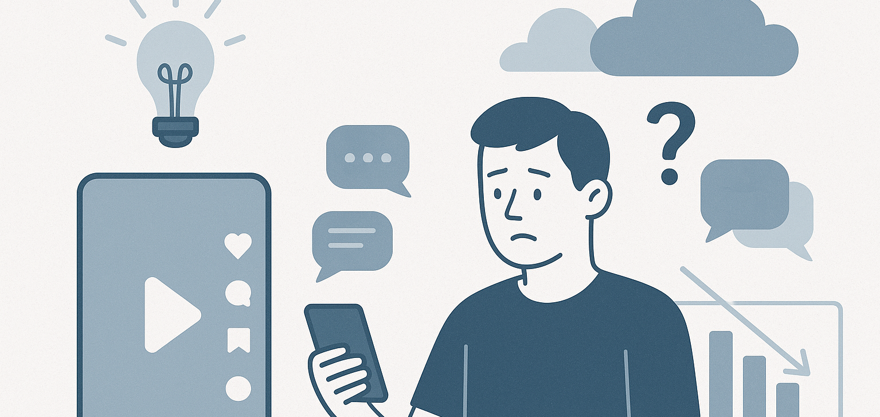
Department of Political Science
Scrolling Through Hate
TikTok, Hate Speech, and Content Moderation
APSA, 11 Sept. 2025
Colin Henry Department of Political Science University of Zurich
Created with GPT-4o

Slide 2





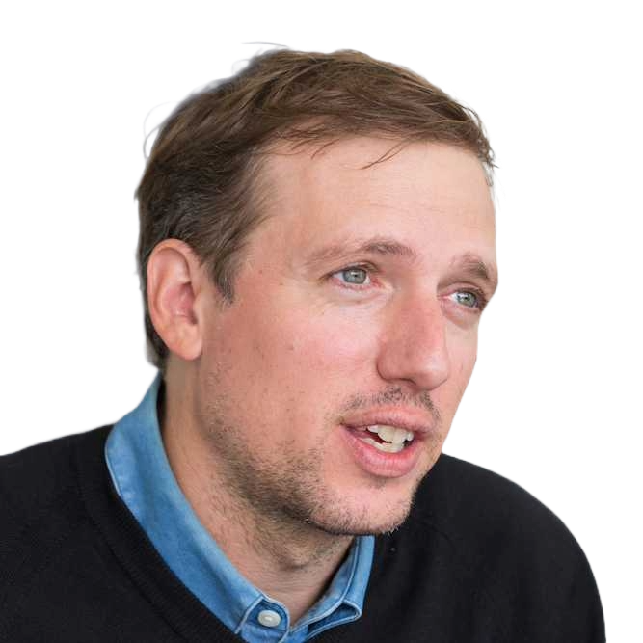

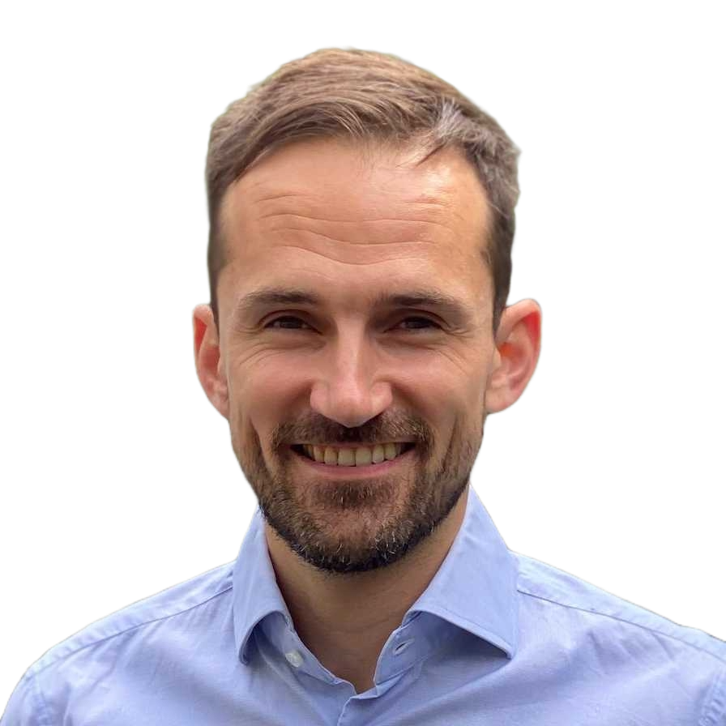



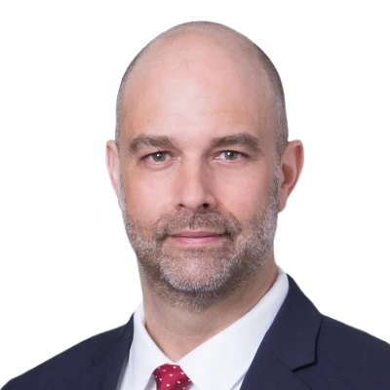

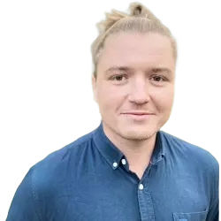

Project Team
UZH/ETH/UCL Team
Colin Henry
Gloria Gennaro
Michael Jacobs
Giuliano Formisano
Dominik Hangartner
Fabrizio Gilardi
Philip Grech
Mathieu Dubied
Core CSMaP Team
Joshua Tucker
Solomon Messing
Benjamin Guinaudeau

Slide 3
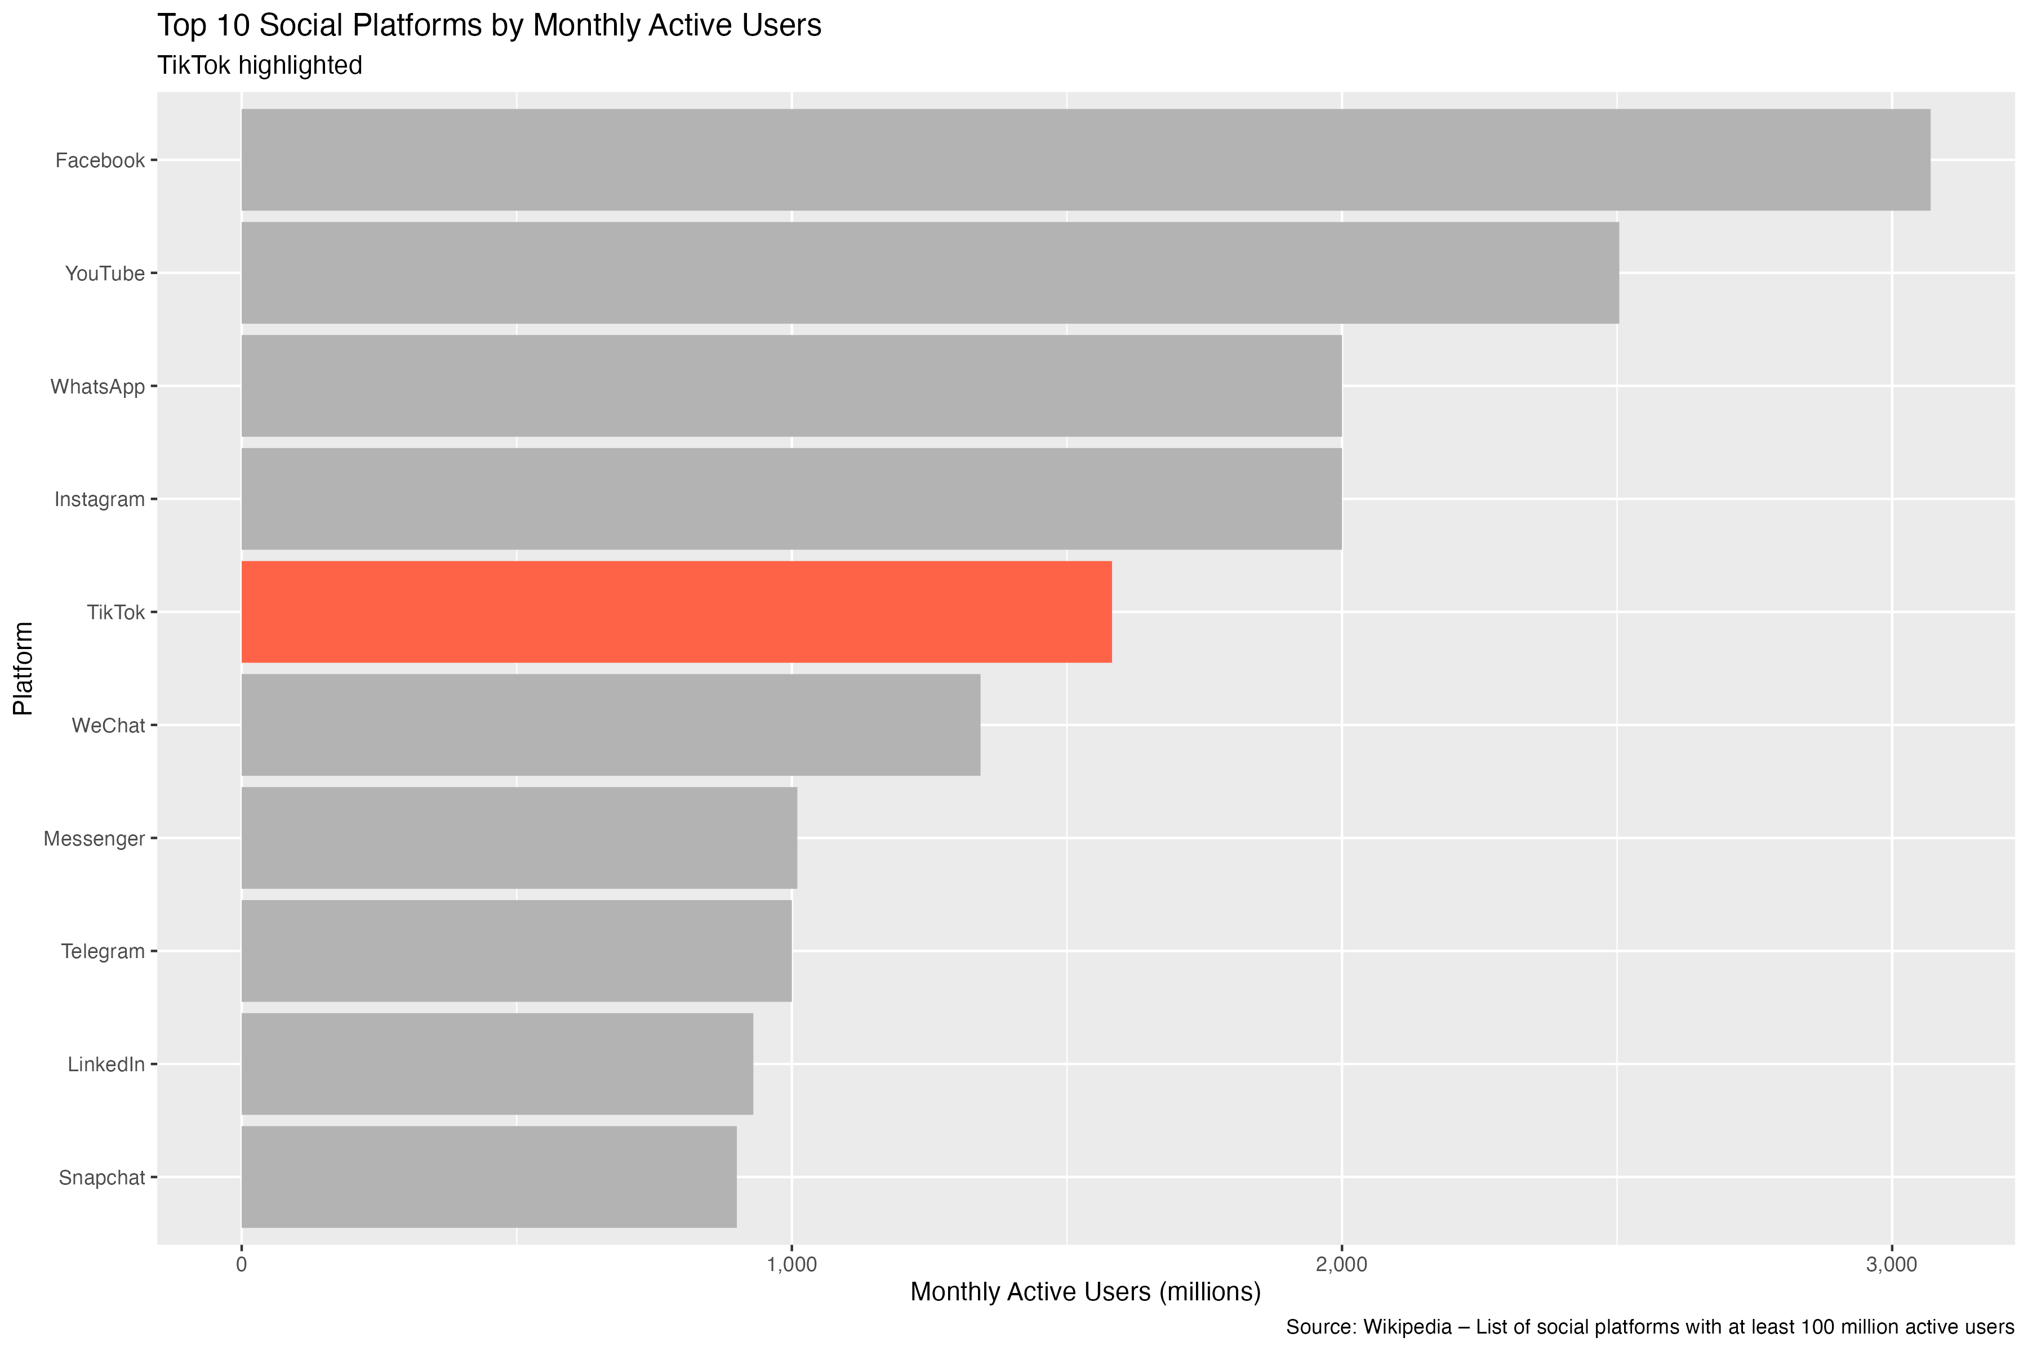
Why TikTok?

Slide 4

Motivation
Why TikTok?
Continuous scroll, short video first mover
Main character in policy debates about content moderation
Which assume saturation with hateful, harmful content
…yet, we have little systematic evidence of content
…and we have limited means of analyzing video, audio content.

Slide 5

Promises
Where the people are
Political speech, behavior increasingly shifting
to new platforms
Richer, higher-context content than pure text
Platform dialects, conversational dialogue
Strategic, multi-modal content

Slide 6

Challenges
But getting there is hard
Limited API access, data donation
Very large-scale data
Computational and storage intensive
Video/audio best practices
Privacy and ethical considerations

Slide 7
Ways Forward
Steel et al (2025)
Complete slice of TikTok based on video IDs
Direct access to the video URLs
Collection requires substantial infrastructure but does not place undue burden on platform (legal situation is unresolved/murky…)

Slide 8

Roadmap
Data collection and scope
Dataset composition
Audio pipeline
Transcription
Classification
Hate speech and abusive speech
Next steps

Slide 9
Data Scope
Overall dataset
Data partnership with NYU CSMaP
8 countries: US, UK, Spain, Argentina, Mexico, Colombia, Peru, Ecuador
(Biggest video producers in English and Spanish)
Representative sample of TikTok posts → baseline, not anecdote
Audio tracks, metadata, comments
One week after video publication
This paper
Mid-January to May, 2025

Slide 10
Dataset Composition
Total videos: 2,582,577
Total audio: 47,609 hours or 1,983 days
Median clip length: 51s, most <90s
English (30%) and Spanish (30%) dominate
Engagement skew: median likes <10, median plays <200

Slide 11
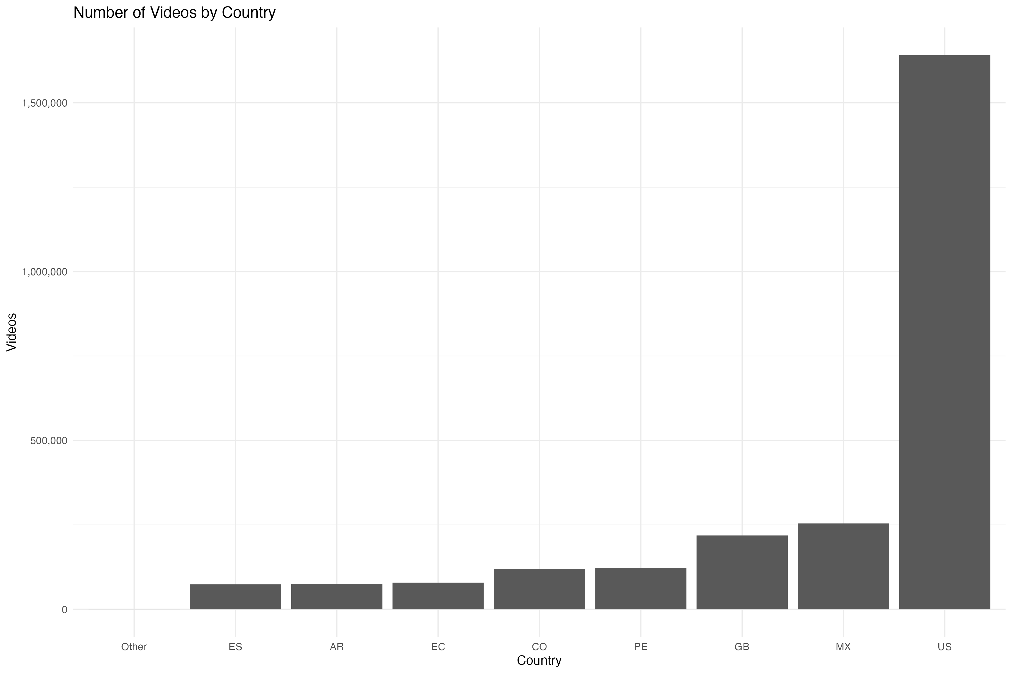
Dataset Composition

Slide 12
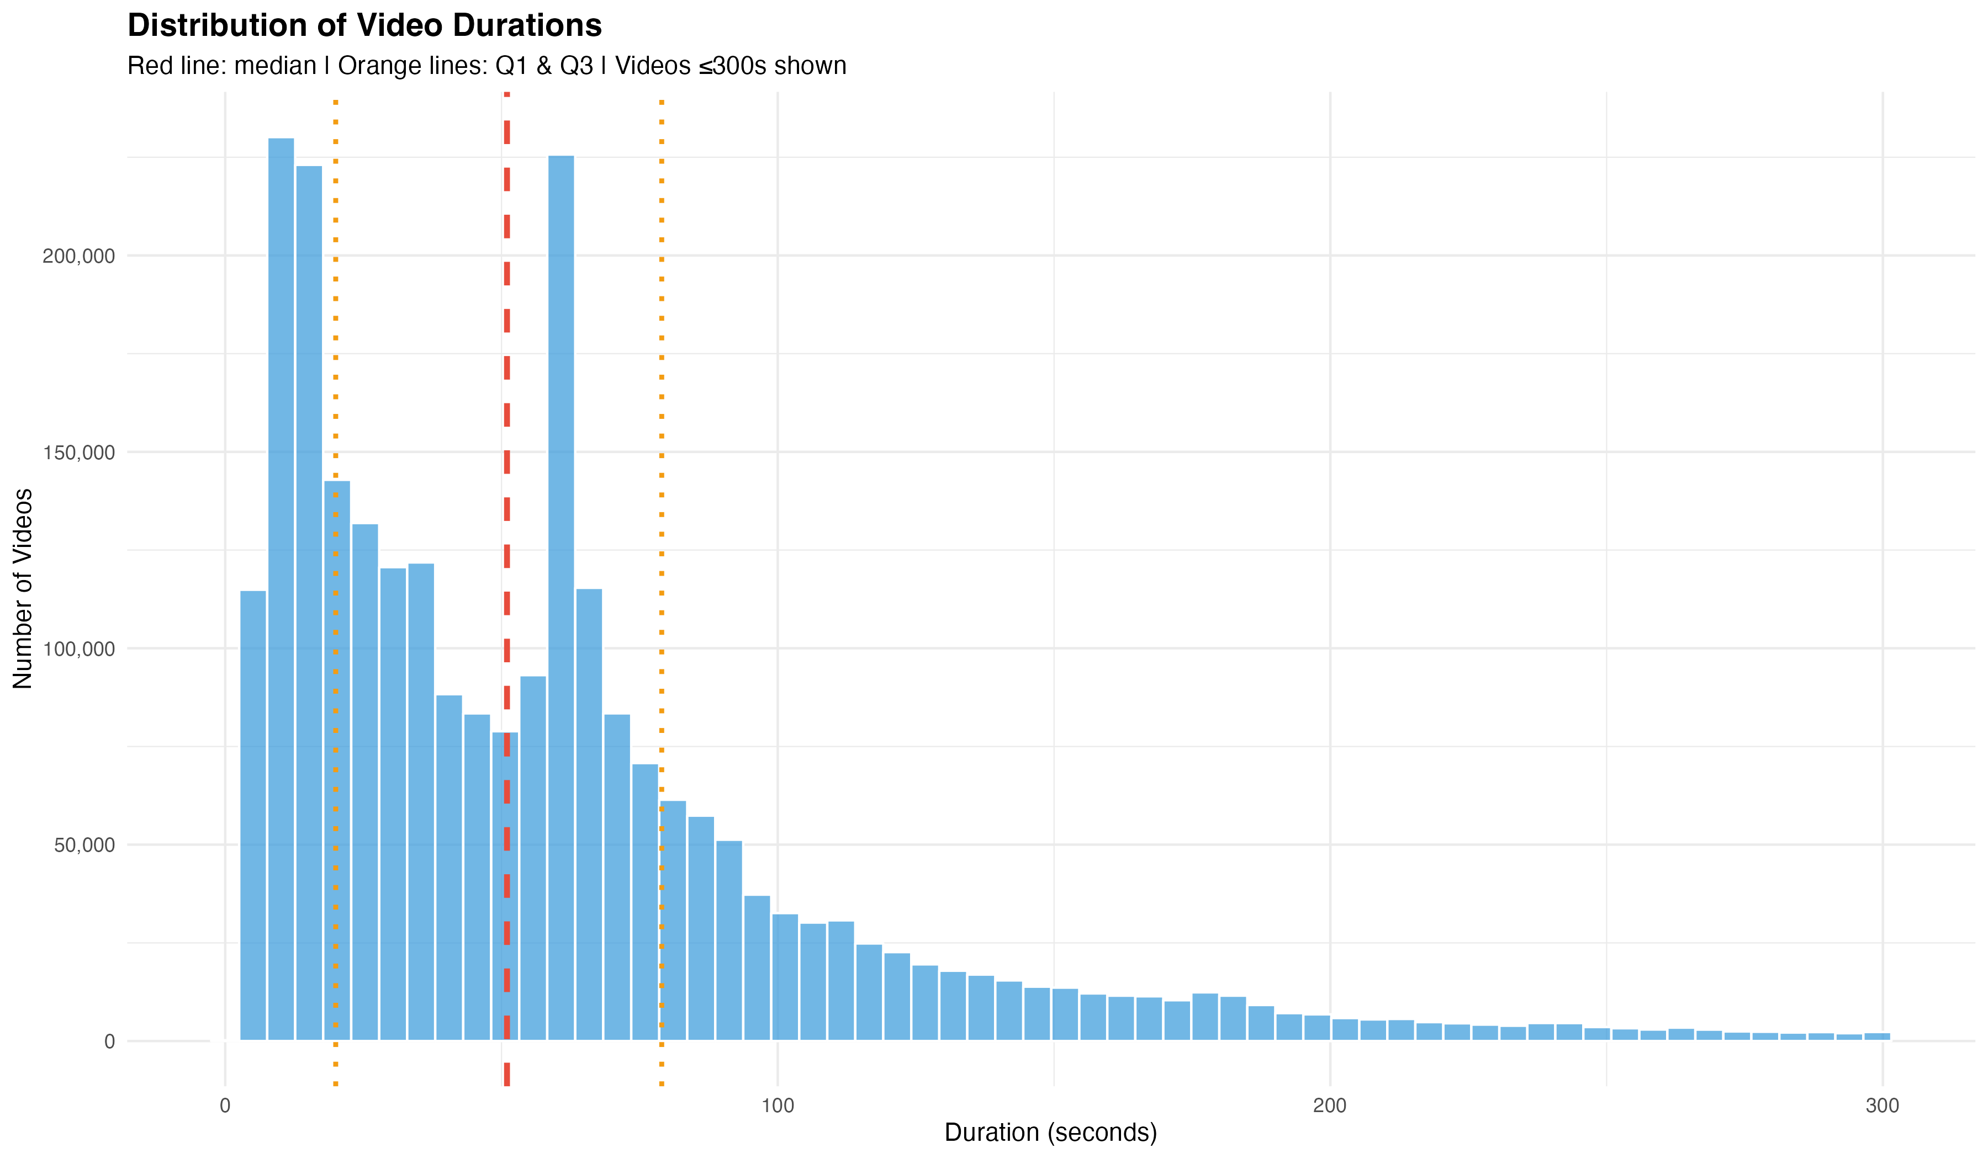
Dataset Composition

Slide 13
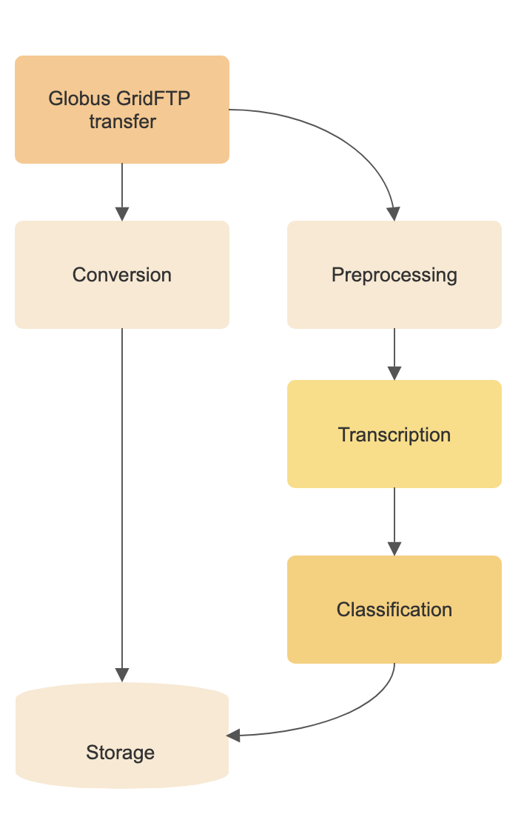
Audio pipeline
Challenge: ~50GB/day of audio
Globus GridFTP transfer for durable, performant data acquisition
Containers + logging + task queue → auditable, reproducible
Built to scale and stay transparent

Slide 14
Transcription
WhisperX: accurate, multi-lingual, diarization + alignment
Pre-processing filters: Deezer to detect music-only, detect non-target languages
Audio standardized from hi-fi MP3 to Opus
Speech fidelity around 16kHz
Low algorithmic delay
Result: robust transcripts for text-based classification

Slide 15
Why Abusive and Hate Speech?
Abusive and hate speech:
Fuels hostility, erodes trust, incites violence (Cao et. al., 2023)
Inflicts psychological harm (Müller and Schwarz, 2023)
Drives away users

Slide 16
Classification Models
Hate speech:
HateBERT (Caselli et. al., 2020)
Fine-tune Llama-2-12B model (Henry, forthcoming)
Abusive speech:
HateBERT Abuseval (Caselli et. al., 2020)
Instruction-tuned CoPE-A-9B (Zentropi, 2025)

Slide 17
Hate Speech Results
Hate speech: rare!
<0.05% of videos flagged
Far below Twitter/Telegram benchmarks
Why so rare?
Aggressive moderation filters at origin? (consistent with TikTok claims)
Users adapt with: memes, euphemisms/emojis, visuals?
Treat as lower bound, not absence

Slide 18
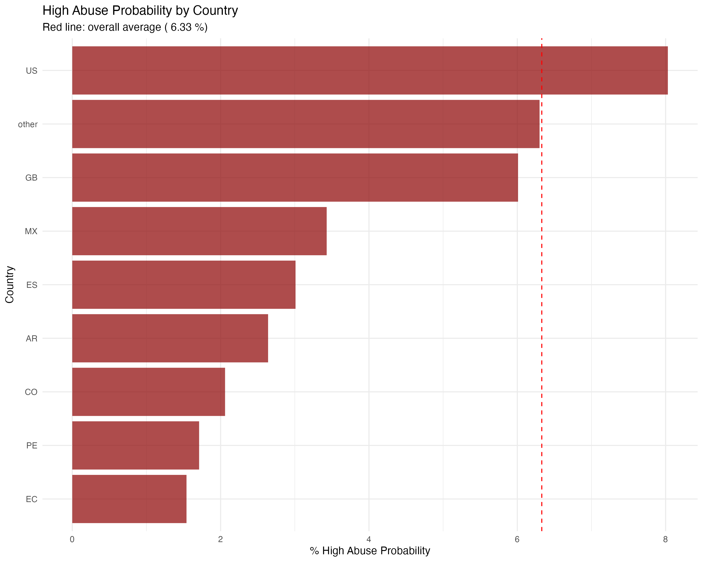
Abusive Speech Results
Abusive speech: ~6% of audios
US highest (8%), UK (6%), Spain (3%), Lat. Am. (1.5-3.5%)
Anglophone > Spanish-speaking contexts

Slide 19
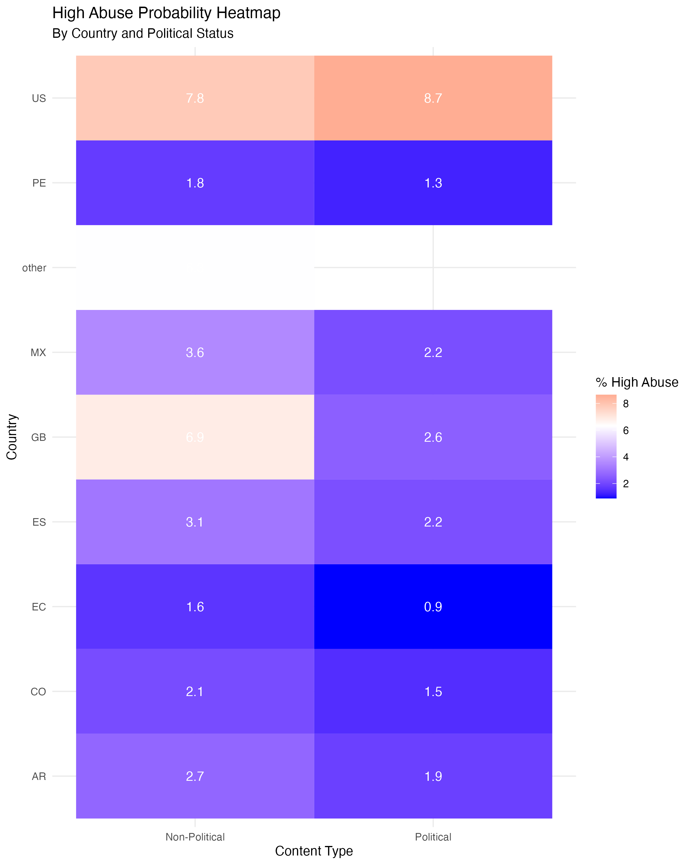
Political vs. non-political content
Political content more likely to contain abusive speech
Only US has higher ratio of abusive speech in Political content
UK, Spain, Lat. Am. all show lower ratios of abusive speech in Political content

Slide 20
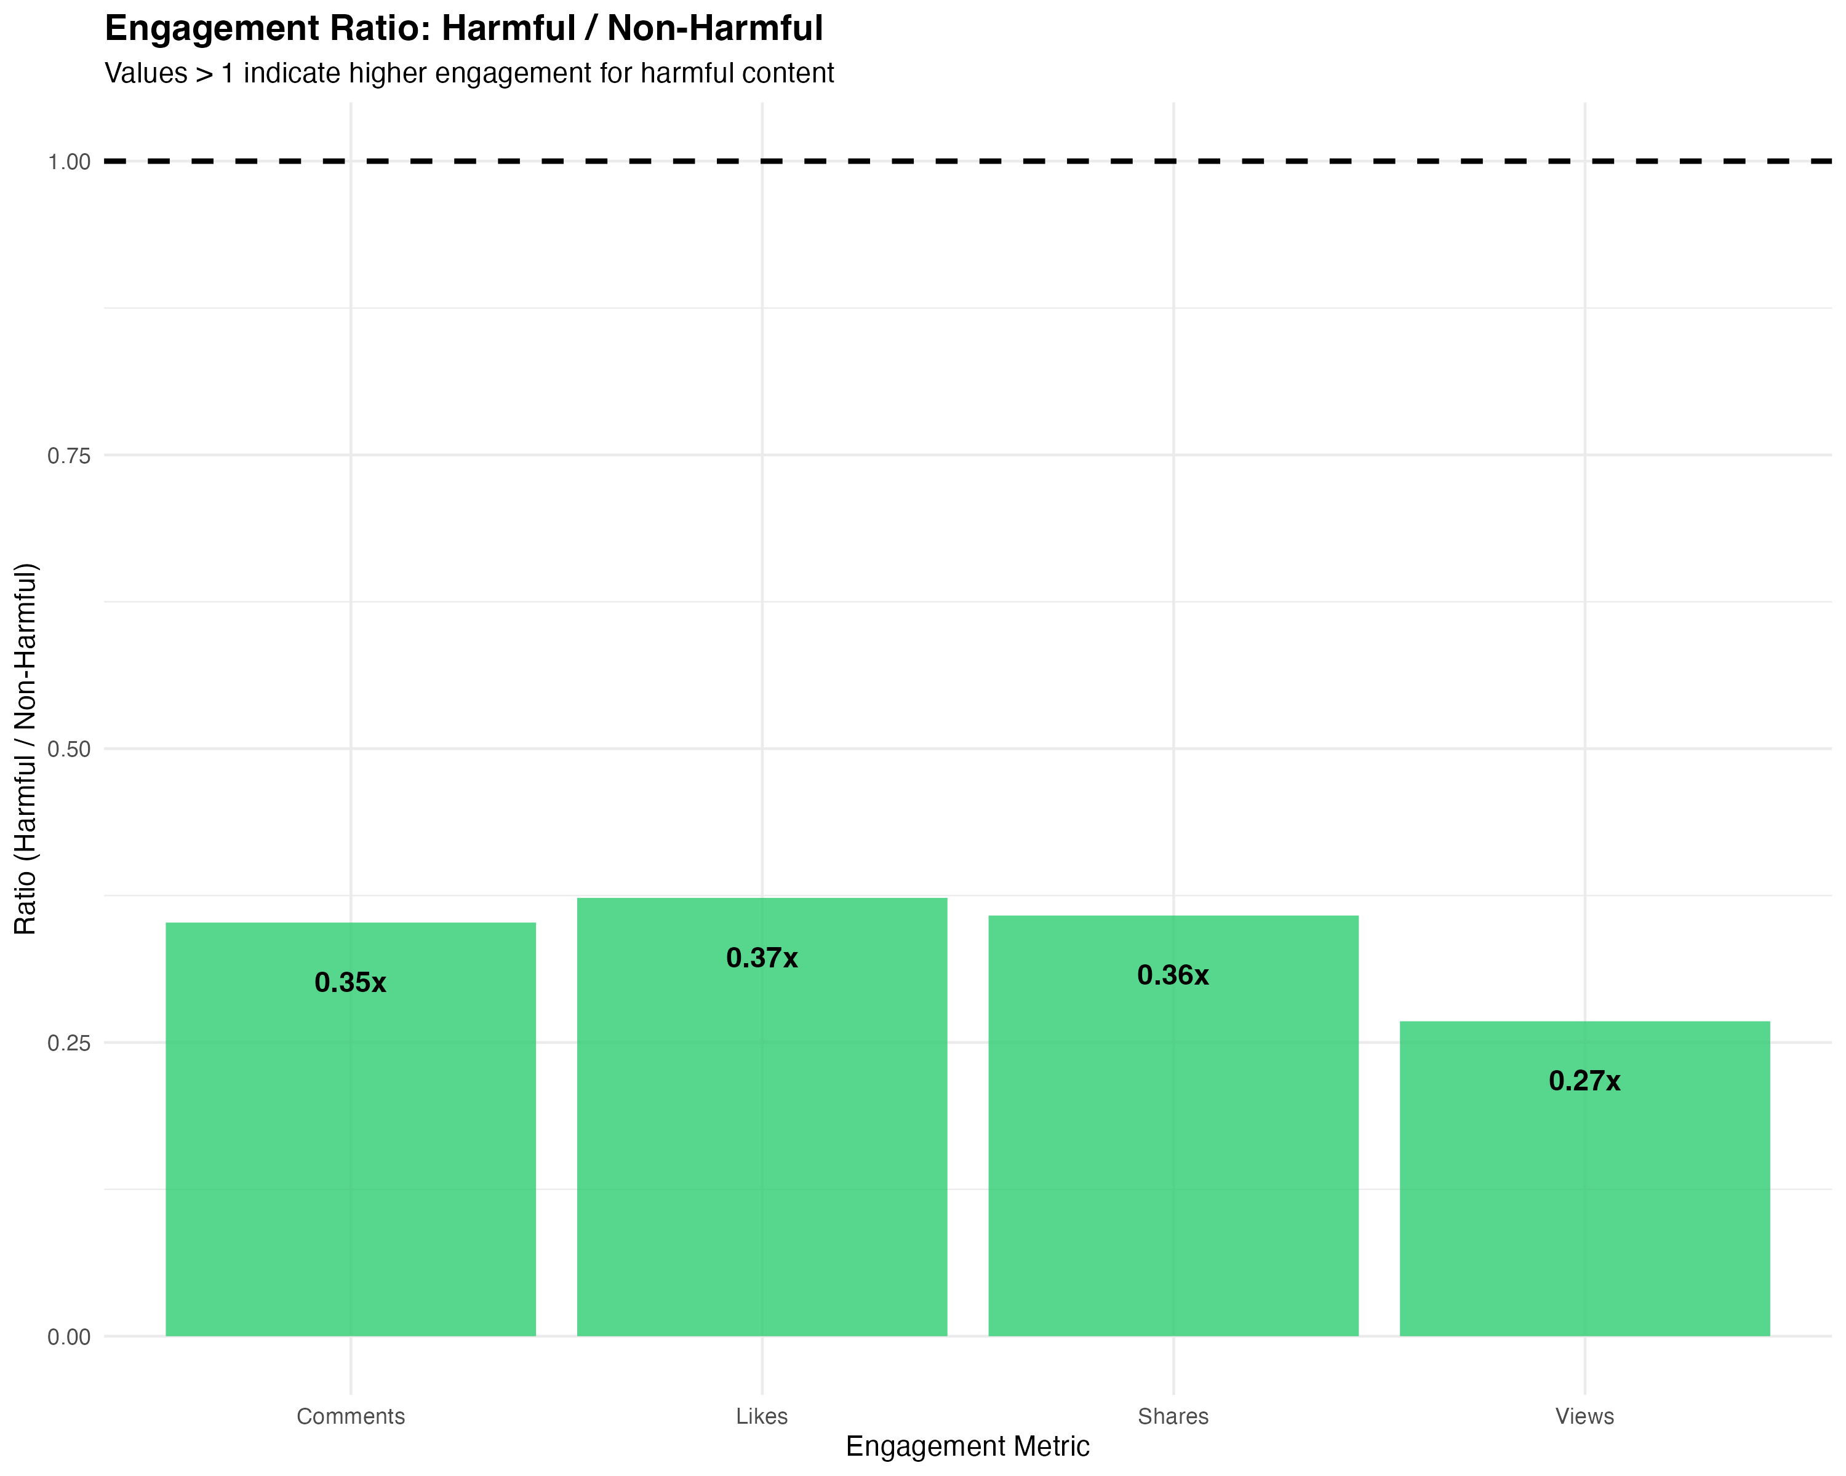
Engagement Patterns
Abusive content is disadvantaged
Compared to ”safe” content:
~63% likes
~63% shares and comments
~73% views
Abuse doesn’t dominate attention economy?

Slide 21
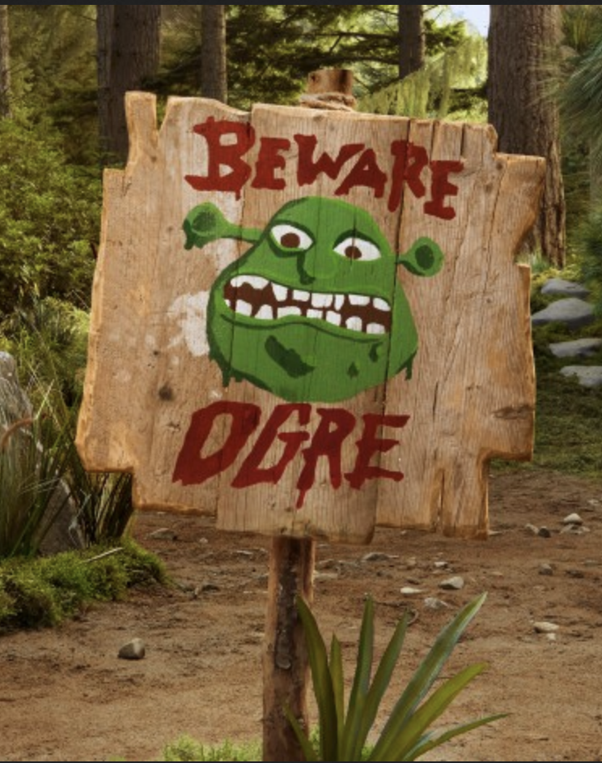
Implications
TikTok not a toxic swamp?
Preliminary patterns suggest so
Hate: very rare (in videos); Abuse: measurable but minority
Abusive speech less visible → User aversion? Moderation?
Limits
Text-first pipeline
Spanish classifiers less than ideal
Highly contextual → coded speech, visual hate, etc.
Hate speech remains severely undertheorized!

Slide 22
Next Steps
Human-coded training data
Native Spanish and English speakers
TikTok/transcript language structures
Comparative work: multi-platform comparisons to baseline
Validation:
Transcription validation (again, native language speakers)
Model validation
Audit study with TikTok Community Guidelines

Slide 23
Department of Political Science
Questions and Answers
Scrolling Through Hate:
TikTok, Hate Speech, and Content Moderation
Colin Henry colin.henry@ipz.uzh.ch
Created with GPT-4o

